Slide 1
Tips, Habits & Grit: What Successful Engineers do to Advance their Careers
Nick Scuola @NScuola
October 2nd, 2019

Slide 2
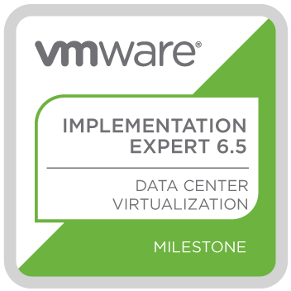



About Me - Nick Scuola - @NScuola
Sr. Solutions Engineer @ Zerto
VMware vExpert PRO
  If you would like to become a vExpert, please reach out
Former NYC VMUG Leader
  Now based in Charlotte, NC
Blog – spookysolutions.com
LinkedIn – NicholasScuola
U.S. Marine Corps Veteran
Part-Time Male Model

Slide 3
Disclaimer
Sharing my personal experiences
No hate, only love
Some things work for me but may not for you
Would love to hear your stories as well
I may or may not have a potty mouth

Slide 4
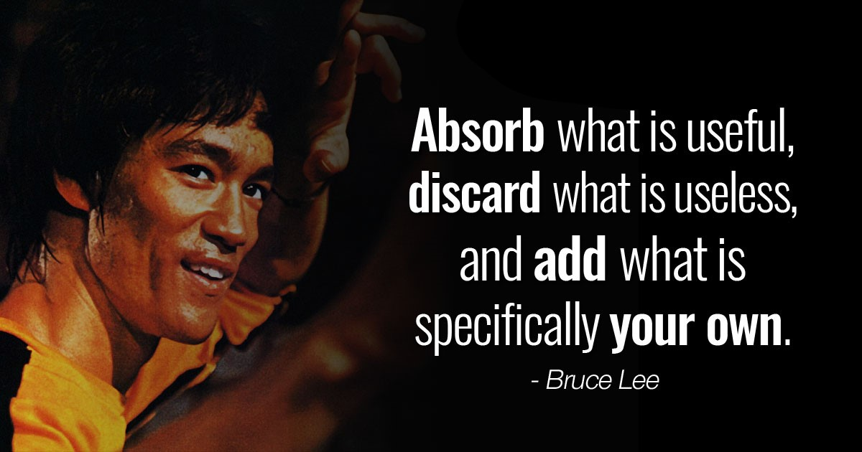

Slide 5
Get Social!
Take a pic of selfie and throw it on Twitter! Use the #ATLVMUG
I really like interacting with people on Twitter and in the #vCommunity – send me (@NScuola) any thoughts from today, your cat pictures and your blog posts!

Slide 6
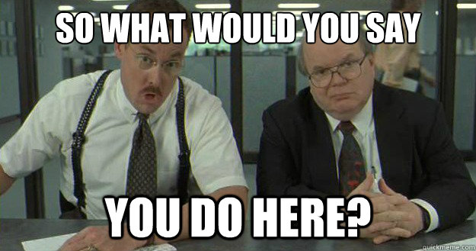

Slide 7
My Career Before
Laser focused on my job (and that’s it)
Did not have insight into other areas
Super technical but task focused
Told what to work on but not why
Typically worked on projects alone or with a small team
Struggled to get new technology in the door
Presentation skills? Who needs those?

Slide 8
Be Educated
Never stop learning
Get Certified, for the right reasons
Know your role, and its expectations
Know the job you want
Home labs are awesome
Hands on labs are awesome too (AND FREE)

Slide 9
Be Organized
Develop (good) habits and routines
  Make your bed
  KISS
Create and follow standards
If you can’t find something, chances are others won’t as well
Learn how to create documentation
Automate as much as possible
Leave a place better than you found it

Slide 10

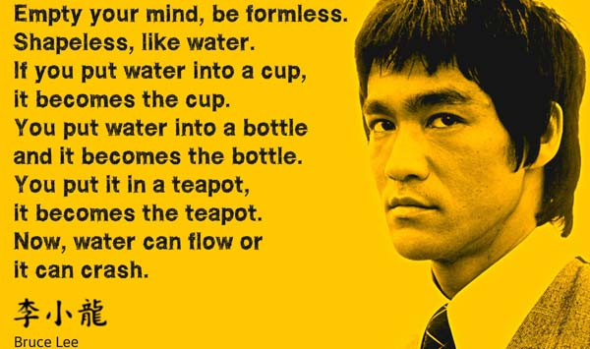
Be Like Water

Slide 11
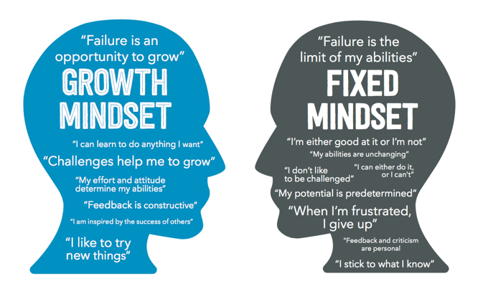
Be Like Water
Adapt, improvise and overcome
Adopt a Growth Mindset
Be a failure
  GOOD!
  Learn from it!
Be audible ready
Have a Plan B

Slide 12
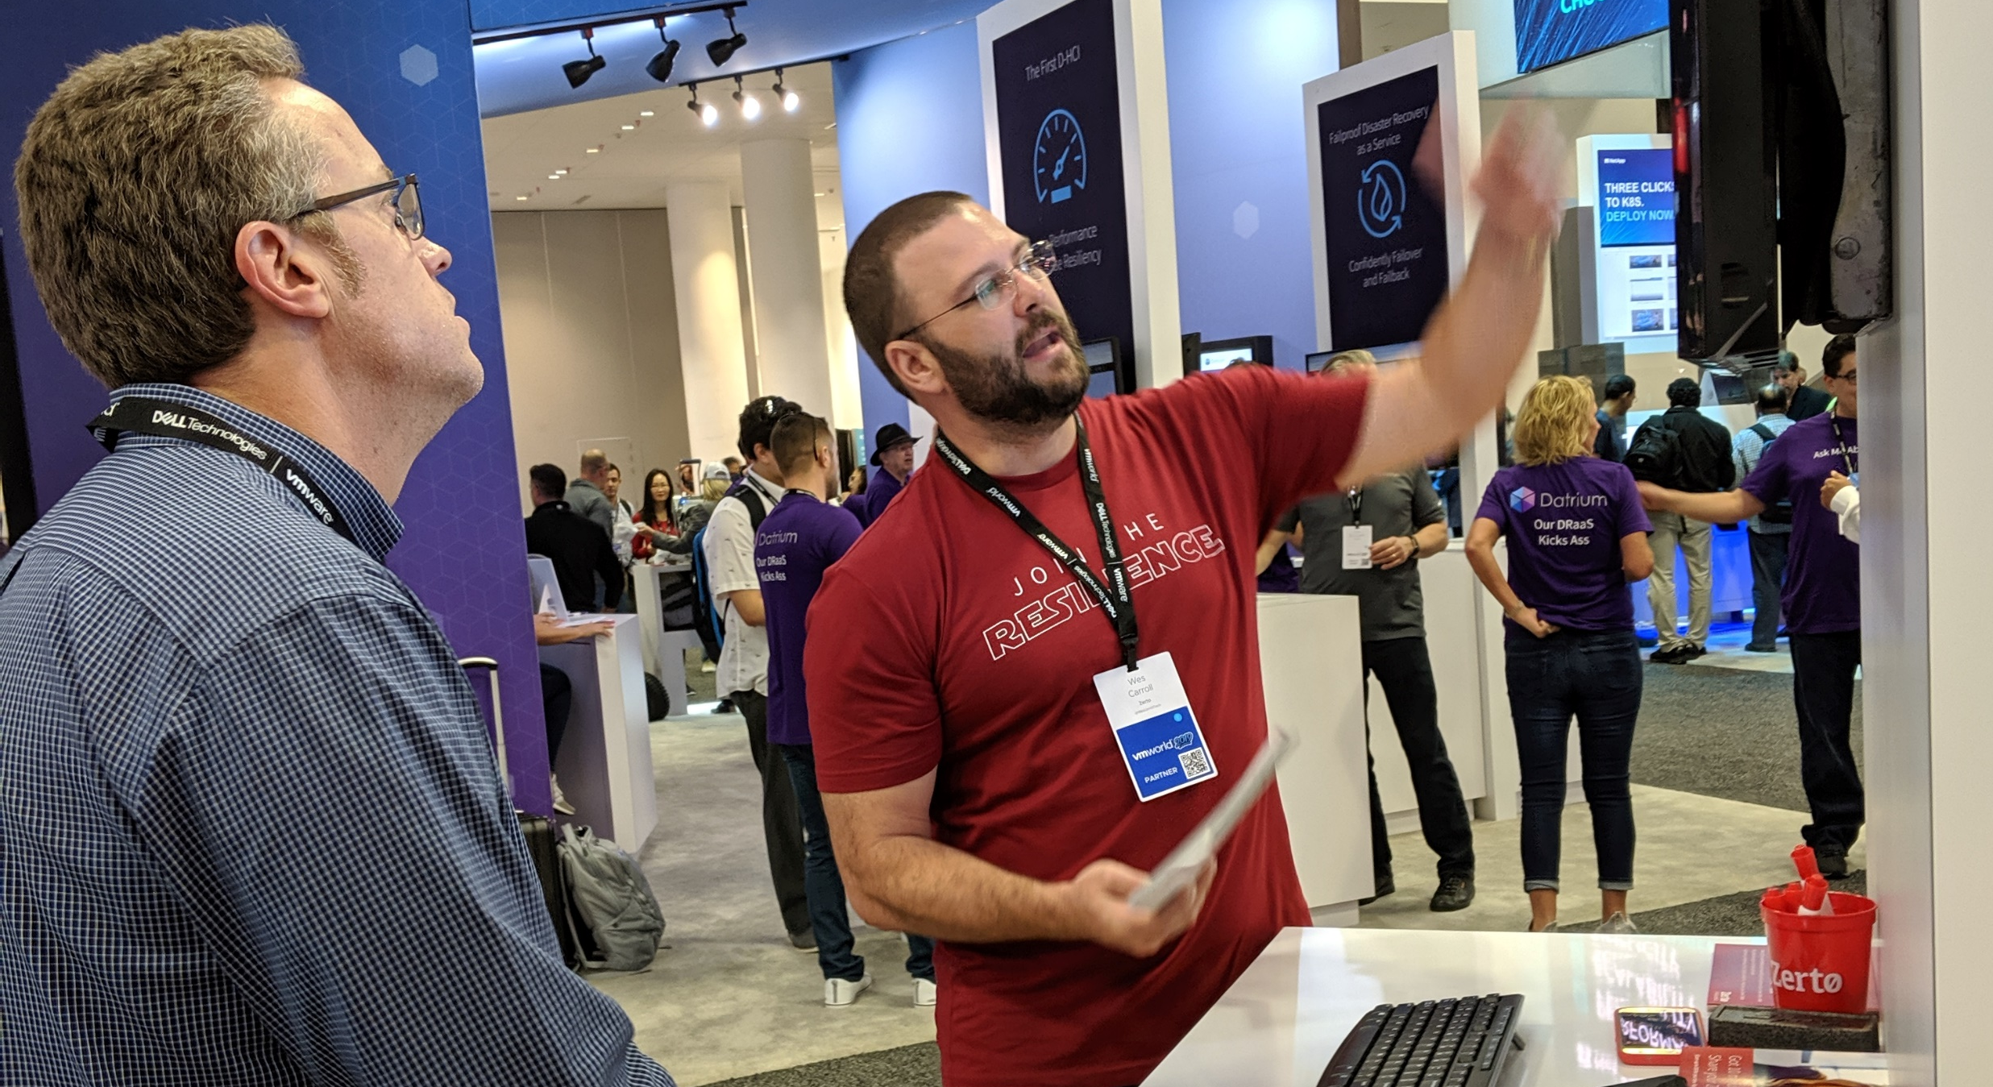
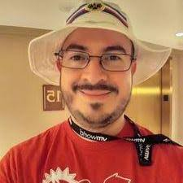
Be Vulnerable
“I don’t know” is OK
Don’t be afraid to ask for help
Seek out a mentor (or mentors)
  vCommunity
  Workplace

Slide 13
Be a Detective
Learn troubleshooting skills – CRITICAL
Knowing the answer is not as important as being able to find the answer
RTFM
  Technical documentation
  Release Notes (Extremely important before upgrades)
  Help Files
  Blogs
Use your blog as a personal help file

Slide 14
Be Approachable
Don’t be that person
Seriously, they suck
Break out of your shell
Be Uncomfortable
Try to find ways to say “Yes”
  If you have to say no, do it constructively
Be a good teammate

Slide 15
Be Collaborative
Look around you
You’re not alone
Share the knowledge
Train others
Be “social”
  VMUG
  VMTN Forums
  Twitter - #vCommunity, #vExpert, #VCDX, #VMUG
  Podcasts – vBrownBag, Geek Whisperers
  Reading, commenting on and sharing blogs
  GitHub
  Slack – VMware Code

Slide 16
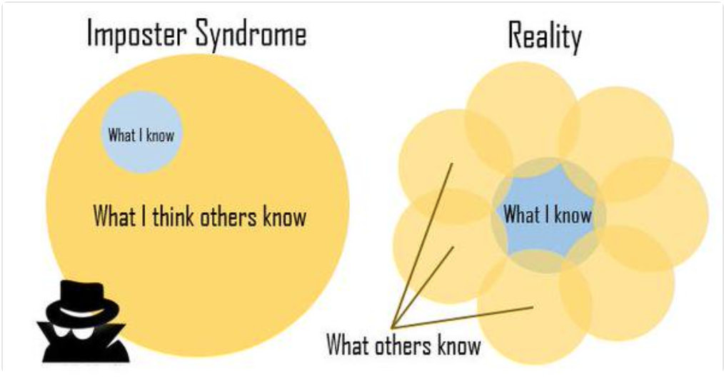
Be Collaborative
4 stages of participation
  Lurk
  Interact
  Contribute
  Mentor
    You will learn so much more from teaching others
    Presenting itself is something that takes practice to do well
    Just try to get better each time. That’s all!

Slide 17
Be Dependable
If you say you will do something, do it
Earn a reputation for getting things done
Do the little things
Put Integrity above all else
  If you say you’re going to do something, do it.
  Use a mindset of Extreme Ownership
  Be a trusted advisor to those you work with
THINK and Listen
Give your full attention to others
Volunteer to help others

Slide 18
Be The Business
Know what your business does
  How do you make money?
  Who are your customers?
  Who are your competitors?
Know your role in the business?
  Where does IT fit in?
  Are you a support organization?
  Do you generate revenue?
Take a business approach
  Check out my vBrownBag session from VMworld
  https://youtu.be/r2HOPhjCffE

Slide 19
Be A Mentor
Give back
  Present
  Mentor
  Help
  Listen
  Train
Lead by example

Slide 20
Be Rested
You can’t work all the time
Time management is important
Make sure you maintain a work/life balance
Don’t lose sight of what is important to you
Burnout is real
Be present

Slide 21
Be Relentless
Never stop improving
Keep learning
Ask questions
Be curious
Be your best self
You are an expert whether you know it or not

Slide 22
My Career After
Focused on the bigger picture
Constantly communicating with other teams
More of an architectural view of the environment
Understand the business drivers behind my work
Projects are more collaborative
Able to work with the latest technology
Present to senior leadership, business unit leadership, executives, vendors

Slide 23
Reading List
Mindset: The New Psychology of Success by Carol S. Dweck
Extreme Ownership by Jocko Willink and Leif Babin
Make Your Bed by Admiral William H. McRaven
The Phoenix Project by Gene Kim, George Spafford, and Kevin Behr
Get out of I.T. while you can by Craig Schiefelbein
Verbal Judo – The Gentle Art Of Persuasion by George J. Thompson, PH.D., and Jerry B. Jenkins
Civil War – A Marvel Comics Event by Mark Millar and Steve McNiven

