Slide 1


vBrownBag
Upgrade Your Technical Skills Using a Business Approach [VMTN5006U]
Nick Scuola - @NScuola
Presented by vBrownBag.com

Slide 2




Nick Scuola - @NScuola
Dad, Husband, Friend, Marine Corps Veteran
#vCommunity Enabler
  vExpert PRO
  Former VMUG Leader
Work @ Zerto, Senior Solutions Engineer
  nick@zerto.com
Blog @ SpookySolutions.com
Part-time Male Model

Slide 3
Disclaimer
Sharing my personal experiences.
No hate, only love.
Some things work for me but may not for you.
Would love to hear your stories as well.

Slide 4
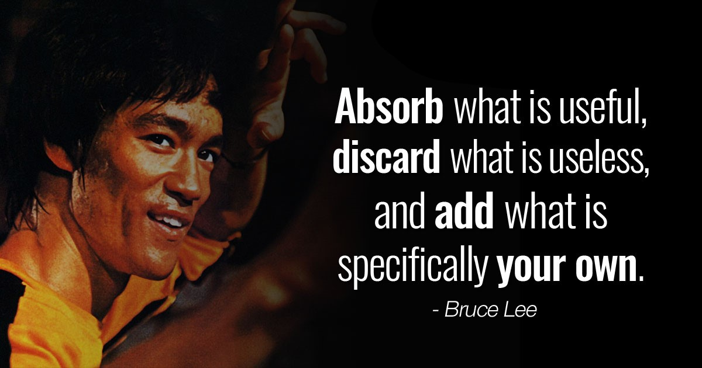

Slide 5
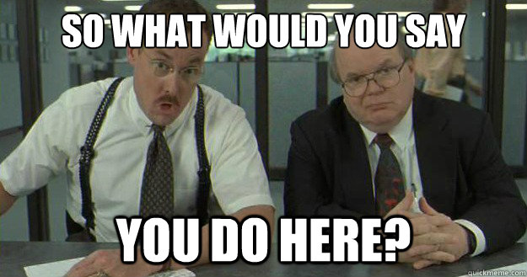

Slide 6
My Career Before
Laser focused on my job (and that’s it)
Did not have insight into other areas
Super technical but task focused
Told what to work on but not why
Typically worked on projects alone or with a small team
Struggled to get new technology in the door
Presentation skills? Who needs those?

Slide 7
My Career After
Focused on the bigger picture
Constantly communicating with other teams
More of an architectural view of the environment
Understand the business drivers behind my work
Projects are more collaborative
Able to work with the latest technology
Able to present to senior leadership, business unit leadership, executives, vendors

Slide 8
What are you doing?
Have you identified the business pain that you are trying to solve for?
  It is process related?
  Technology related?
  Is it affecting your internal users?
  Is it affecting customers?
What is the end state that you want to achieve?
  Have you identified the agreed upon outcomes that the business wants to see?

Slide 9
Who is driving this?
Is this something you are pushing?
  Will it make your job easier?
  Will it save or cost the company money?
Are you being asked to take on this work by someone else?
Is this part of the overall company strategy or is it a departmental one?

Slide 10
Why are you doing this?
What’s driving this work?
What is the business goal associated with this work?
Is this going to save/make money?
Will this impact your customers or employees in a positive way?
  Financially
  Operationally
Who have you talked to?
  Have you verified the requirements?

Slide 11
When does it need to be done by?
Is there a hard timeline?
Is there a penalty if you don’t finish in time?
  Ex. Evacuate a datacenter by the end of the lease.
  Are there other projects reliant upon this one?
How does this project stack up against others in the queue?

Slide 12
Where is this taking place?
Is this project going to involve just your team?
Do you need to get other groups involved?
Are they local? Or are they located in other locations?
What business units are going to be affected by this work?
  Do you need a maintenance/downtime window?
  Will your end users be affected? For how long?

Slide 13
How are you going to do it?
Can you use existing tools?
Do you need to make a purchase?
What’s the learning curve for the team?
Will it impact operations today or in the future?
Do you know anyone that has gone through this process before?
  If so, have you talked to them?

Slide 14
Did you do what you needed to?
Were you able to solve the business problem you set out to?
What was the positive business outcome?
How did you verify?
  Did you get sign off from app teams?
  Have the end users/customers tested?
Can you quantify the benefits?
  Did you save money?
  Did it make the company money?

Slide 15
Closing Thoughts
You can use these methods in your every day lives
Prioritize tasks
Don’t be afraid to ask for help
Plan for the future but be in the moment
Think like a customer

